Slide 1
Predicting Prenatal Health with Machine Learning
Ironhack final project - Alessia

Slide 2
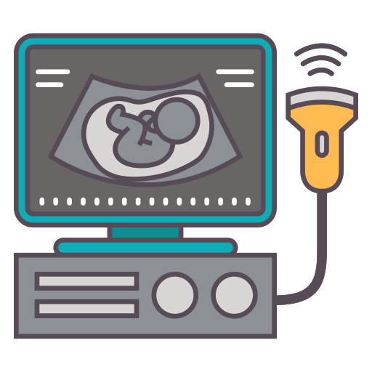
Introduction
In 2015, 45% of under-5 mortality occurred during the neonatal period, primarily due to birth complications (35%), intrapartum events (25%), and infections like sepsis or meningitis (15%) Liu L. et al. Lancet (2016)
Cardiotocography (CTG) is used to assess fetal well-being during pregnancy. It helps identify complications and ensures timely medical intervention to protect both mother and baby
CTGs measure fetal heart rate (FHR), variability, accelerations, and decelerations and are classified as:
Normal
Suspect
Pathological
Notes:
It is primarily used in the third trimester or during labor, especially in high-risk pregnancies

Slide 3
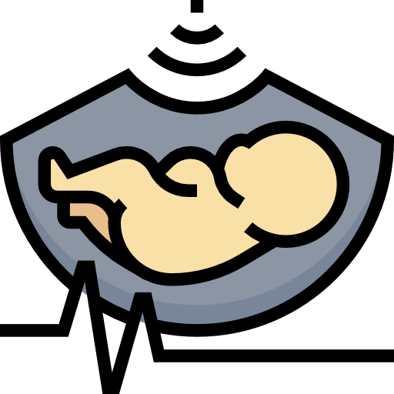
Objective
Analysing CTGs and drawing conclusions is challenging, especially in underdeveloped countries due to a shortage of skilled medical professionals
AIM:
develop a machine learning model to accurately predict high risk fetuses based on CTG exams results

Slide 4


Data Overview
Dataset
Target
Fetal Health Classification (Kaggle):
2126 Rows and 22 columns
No NaN
13 Duplicated values (dropped)
All columns are Floats, including “Fetal Health”
“Fetal Health”:
1 = Normal
2 = Suspect
3 = Pathological
Classification Problem
Ayres de Campos et al. (2000) J Matern Fetal Med 5:311-318

Slide 5
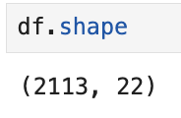
Project Workflow
Tableau visualization
Machine Learning
Data exploration & cleaning
https://public.tableau.com/app/profile/urzi.alessia/viz/final_project_Ironhack/Dashboard12?publish=yes
Classification models: KNN, AdABoost, RF, GradientBoost, XGBoost
Removing duplicated values
Conversion of target col into N, S, P for better visualization
1
2
3
4
5
EDA
Pre-modeling
Target and Features distributions
ANOVA testing
Feature importance
Resampling
Feature engineering
Data Transformation

Slide 6
Tableau visualization
Tableau Dashboard: Link

Slide 7
Features Distribution
Most Features follow a normal distribution pattern (FHR max, FHR median, FHR mean, FHR mode, base FHR)
However, some Features are highly skewed (fetal movements, accelerations, decelerations, FHR variance)

Slide 8


Machine Learning process
Imbalance
Before SMOTE
After SMOTE
SMOTE was used to resample the target column
N
1316
N
1316
S
234
S
1316
Transformation
Robust Scaler:
Presence of outliers
Skewed distributions
P
140
P
1316
Feature engineering
Conversion of target into numeric values with Label Encoder (XGBoost), then decodified for interpretation

Slide 9
Machine Learning Models
A GridSearch was run to identify the best parameters for KNN, AdaBoost, GradientBoosting, RF, and XGBoost
The best parameters were then applied to train each Model
Model | Avg. Accuracy (weighted) | Avg. Precision (weighted) | Avg. Recall (weighted) | Avg. F1 Score (weighted) | Avg. Cohen's Kappa
AdaBoost | 0.90 | 0.93 | 0.90 | 0.91 | 0.75
K-Nearest Neighbors | 0.92 | 0.93 | 0.92 | 0.92 | 0.80
Gradient Boosting | 0.96 | 0.96 | 0.96 | 0.96 | 0.88
Random Forest | 0.96 | 0.96 | 0.96 | 0.96 | 0.88
XGBoost | 0.97 | 0.97 | 0.97 | 0.97 | 0.91
→ XGBoost algorithm does not require a normal distribution and is not affected by outliers and class imbalance

Slide 10
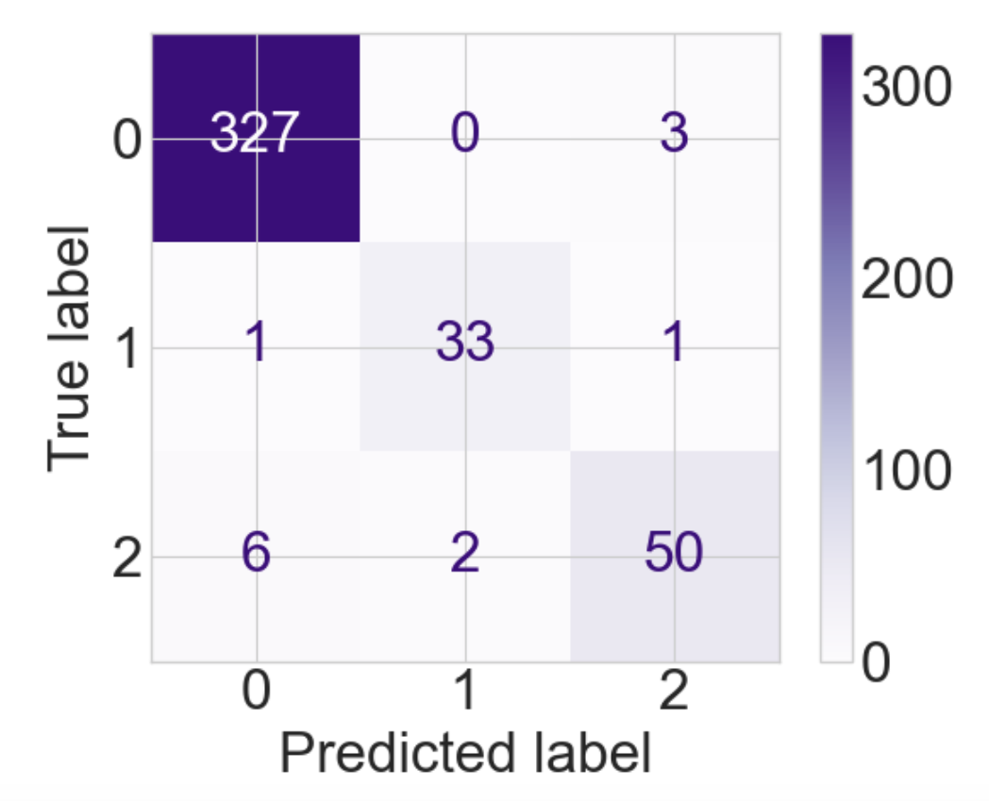
Using XGBoost to predict fetal health
XGB Classification report
Confusion Matrix
 | Precision | Recall | F1-score | Support
Normal | 0.98 | 0.99 | 0.98 | 330
Pathological | 0.94 | 0.94 | 0.94 | 35
Suspect | 0.93 | 0.86 | 0.89 | 58
Weighted Avg | 0.97 | 0.97 | 0.97
N
P
S
Accuracy | 0.97

Slide 11
XGBoost Train vs Test
Metric | Avg. Accuracy (weighted) | Avg. Precision (weighted) | Avg. Recall (weighted) | Avg. F1 Score (weighted) | Avg. Cohen's Kappa
Training Set | 0.99 | 0.99 | 0.99 | 0.99 | 0.99
Test set | 0.97 | 0.97 | 0.97 | 0.97 | 0.91
XGBoost Model is generalizing well on both training and test sets

Slide 12
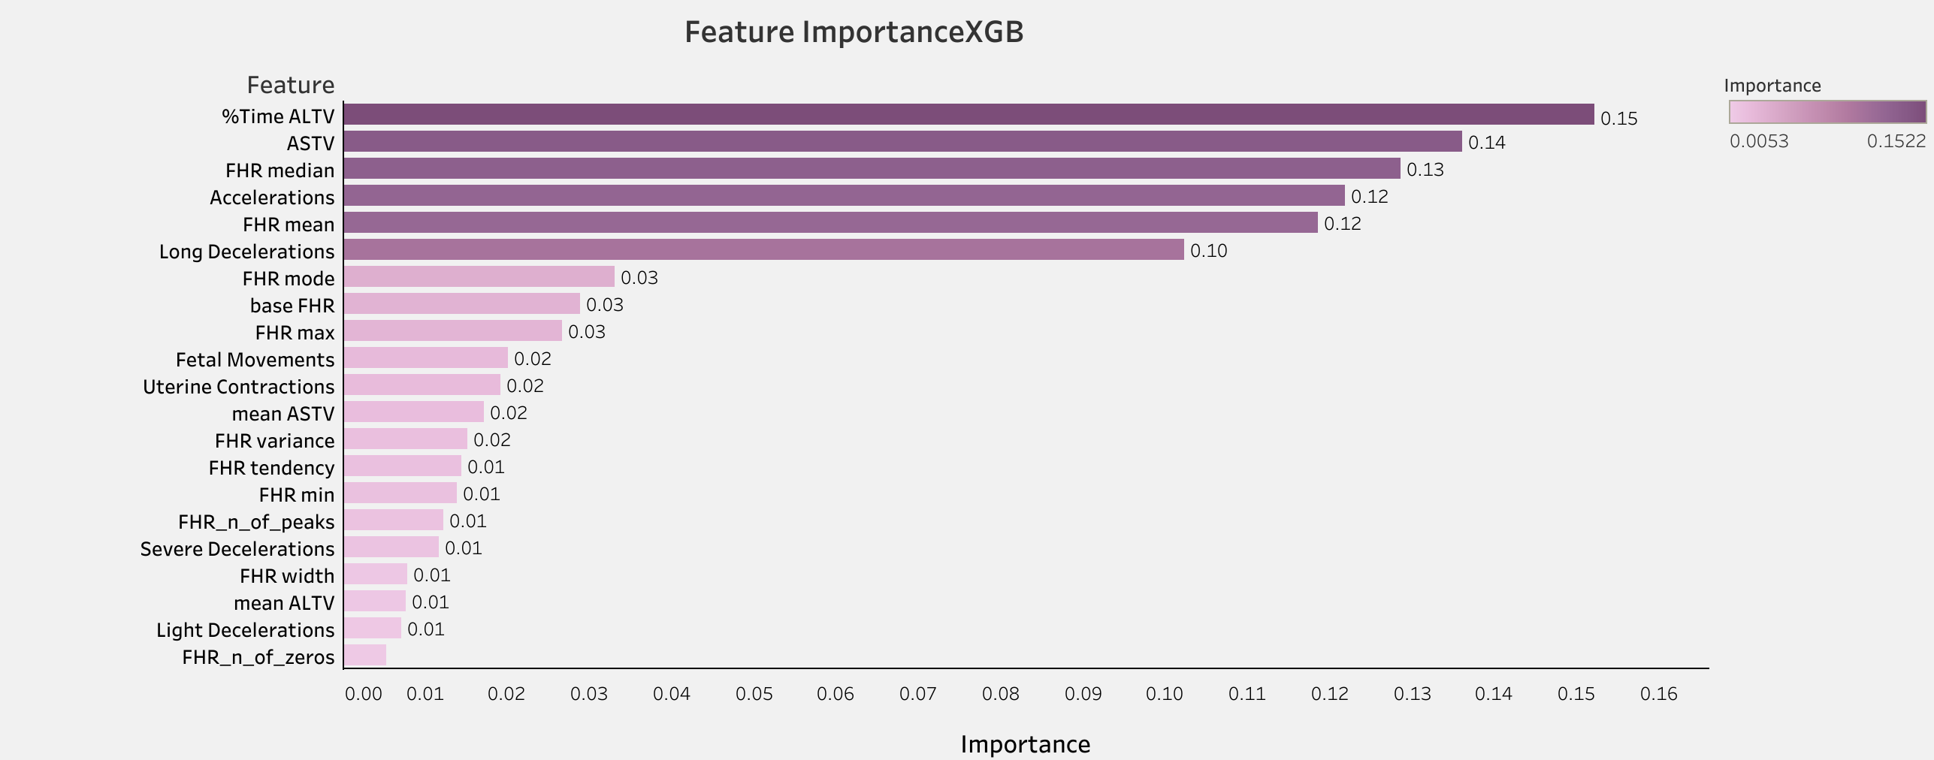
XGBoost Feature Importance
Notes:
SelectKBest uses statistical tests such as the chi-square test, ANOVA F test, or mutual information score to evaluate and rank features based on their correlation with the target variable. It then selects the top K features with the most important importance score to be included in the final feature subset.

Slide 13
Correlation Matrix
Features Correlation
HIGHLY CORRELATED FEATURES (> 0.75):
baseline_value_FHR(BPM) and FHR_median FHR_width and FHR_min
FHR_min and FHR_width
FHR_mode and FHR_mean
FHR_mode and FHR_median
FHR_mean and FHR_mode
FHR_mean and FHR_median
FHR_median and baseline_value_FHR(BPM)
FHR_median and FHR_mode
FHR_median and FHR_mean
Highly correlated features could be removed to avoid redundancy

Slide 14
Future Improvements
Feature importance
Keeping only most important Features
Feature correlation
Removing highly correlated features to reduce redundancy
Re-Train XGBoost
Re-train XGB Model with these implementations to further improve performance and clarity

Slide 15

Real Life application
Streamlit App demo: FetalHealth
This application is designed to assist in identifying high-risk fetuses, even without trained medical professionals.
By inputting values from a CTG examination below, you can obtain predictions regarding fetal health status.
Link to App:
https://aleurzi-final-project-ironhack-streamlitapp-ln2uq4.streamlit.app/

Slide 16
Thank you!
Kaggle Dataset: Link
Tableau Dashboard: Link
Streamlit App: Link
Ayres de Campos et al. (2000) J Matern Fetal Med 5:311-318

